Slide 1
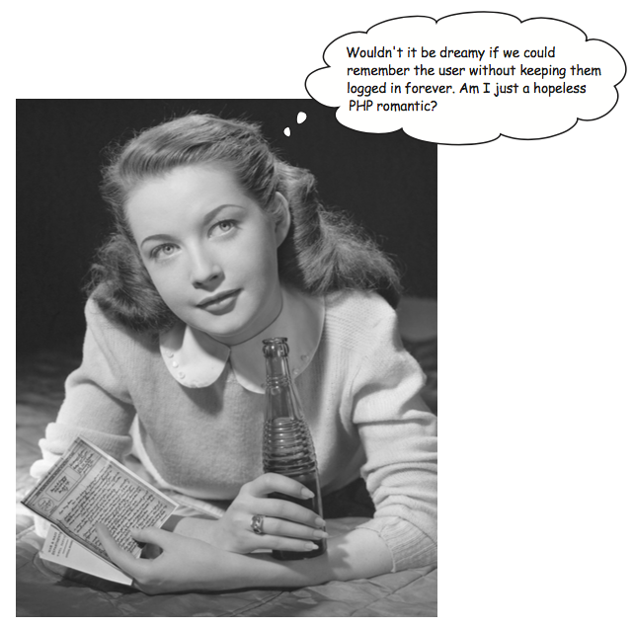
User Authentication

Slide 2
Files You Will Need
New to download from Canvas
setcookie.php
readcookie.php
index.html
authcookie.php
Existing in your contacts files
header.php
showcontacts.php

Slide 3
Objectives
Describe “state”
List techniques to add state
Describe the use of cookies
Describe how the use of cookies can maintain state
Create, use and destroy cookies
Use developer tools to view cookies
Describe the login process
Use cookies to authenticate login and logout

Slide 4
Remember Me?
Web applications don’t remember people (or computers) automatically.
Up to you – the developer to code the app to remember.
This is called “state”
HTTP is a “stateless protocol”

Slide 6
Techniques to add State
Sessions and cookies
PHP uses a cookie to store a session ID.
The browser passes the cookie to the server with each request.
URL encoding and sessions
Used to provide session tracking when cookies are disabled.
Stores the session ID in the URL for each page. Not recommended.

Slide 8
Cookies
Way for a server to store information on the user’s machine.
One way a site can remember or track a user.
Like a name tag, you tell the server your name and it gives you a sticker to wear.
Can be disabled by users.
Can be problematic if your application requires them.
Computer and browser specific.

Slide 11
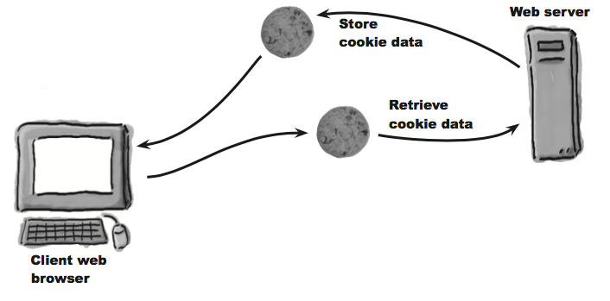
Source: PHP and MySQL for Dynamic Web Sites (5th Ed.) Ullman

Slide 12
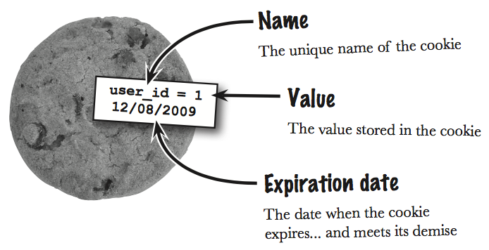
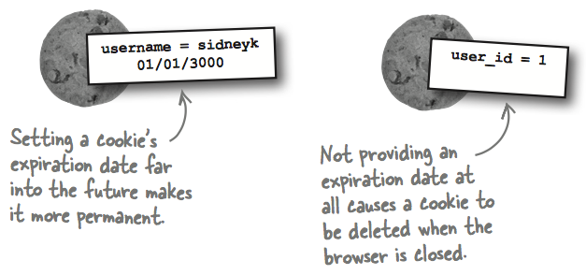
What’s in a cookie?

Slide 14
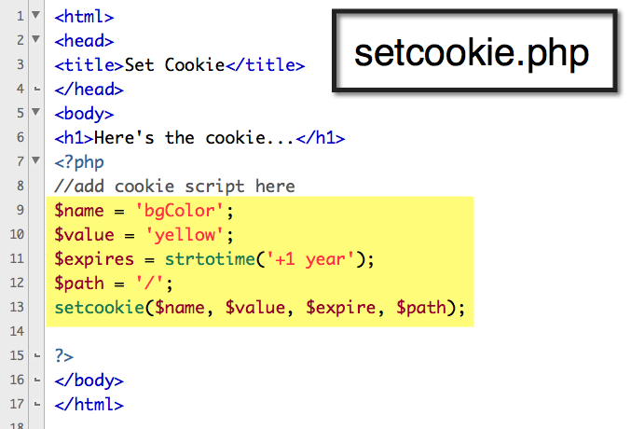

Slide 15
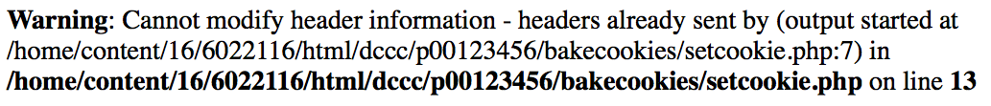
Important to Note
They must be sent from the server to the client prior to any other information.
Should the server attempt to send a cookie after the browser has already received HTML—even an extraneous white space—an error message will result and the cookie will not be sent

Slide 16
headers already sent… error message
Note the script and line number following output started at.
Open that script and head to that line number.
Remove the blank space, line, text, HTML, or whatever that is outputted by that line.

Slide 17
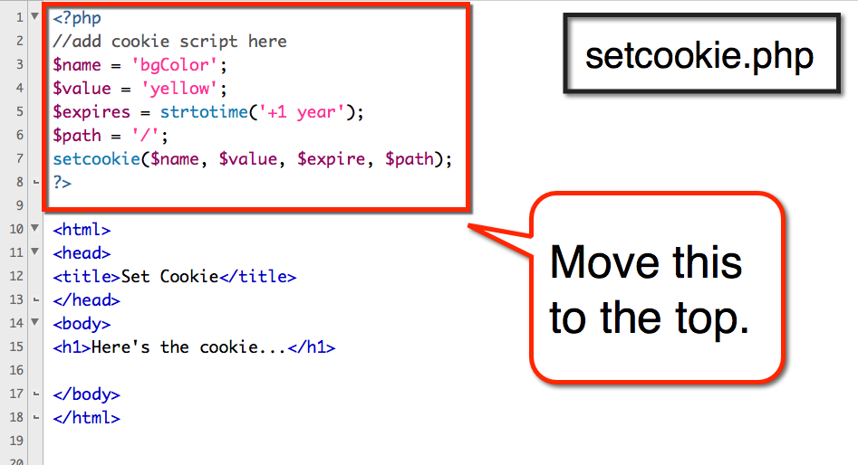

Slide 18
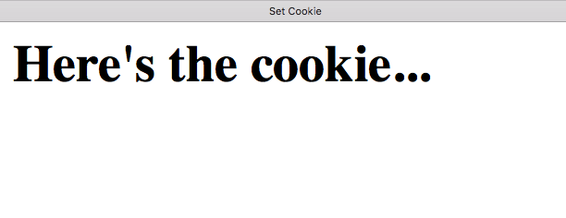
Are we sure it’s there?

Slide 19
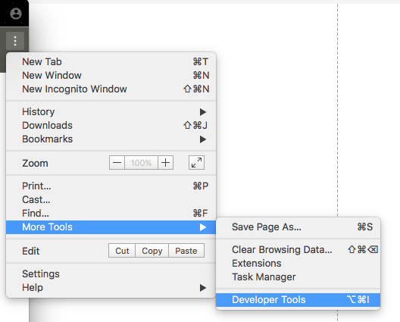
Turn On Chrome Developer Tools

Slide 20
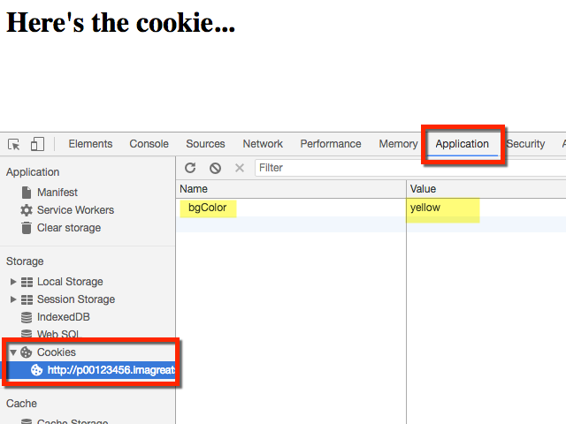

Slide 21
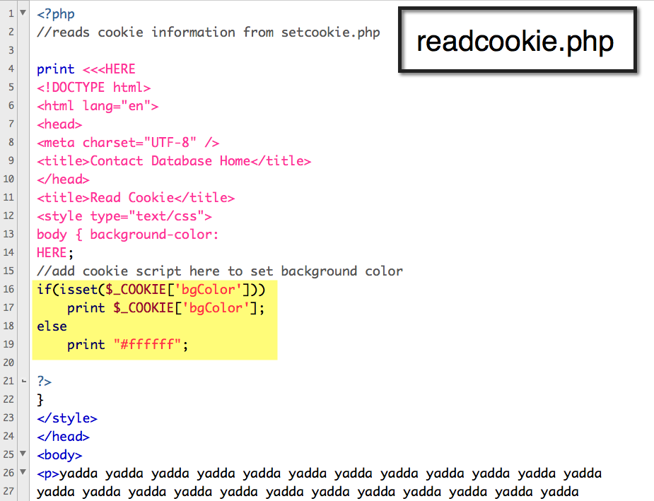

Slide 22
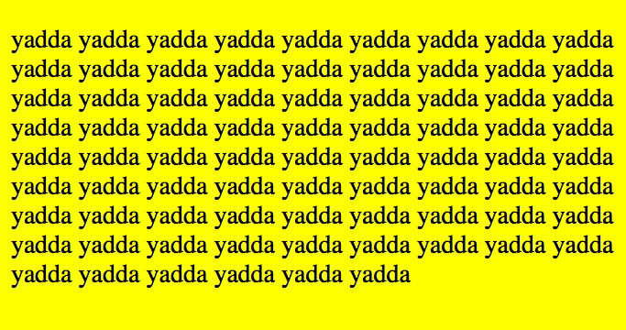

Slide 23
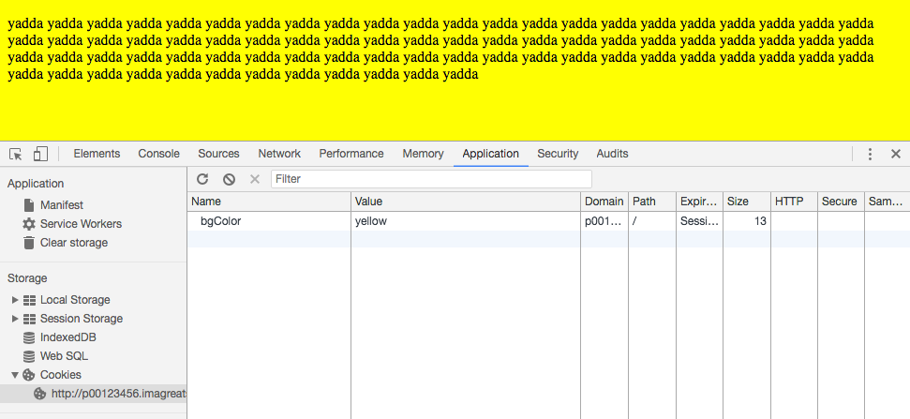
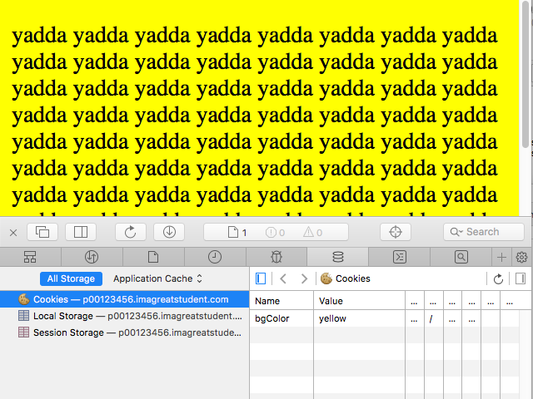

Slide 24
Source: PHP and MySQL for Dynamic Web Sites (5th Ed.) Ullman

Slide 25
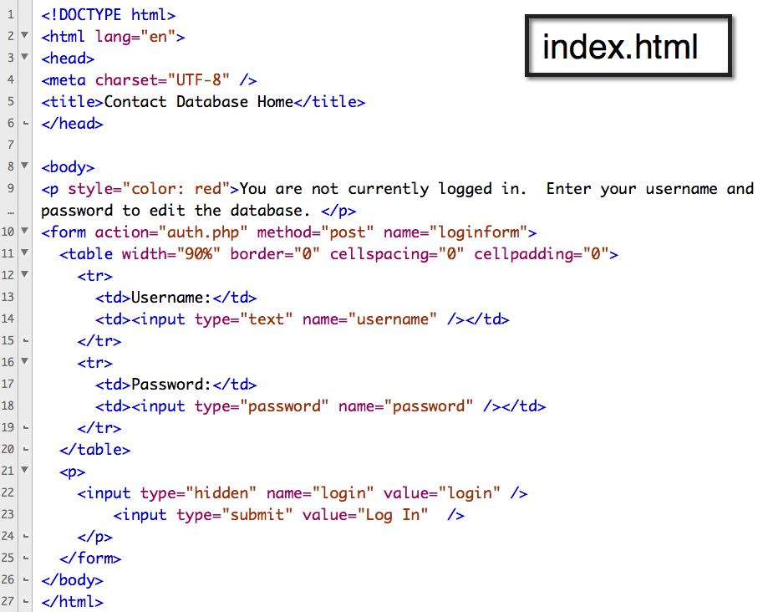
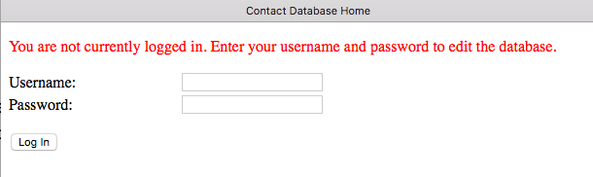

Slide 26
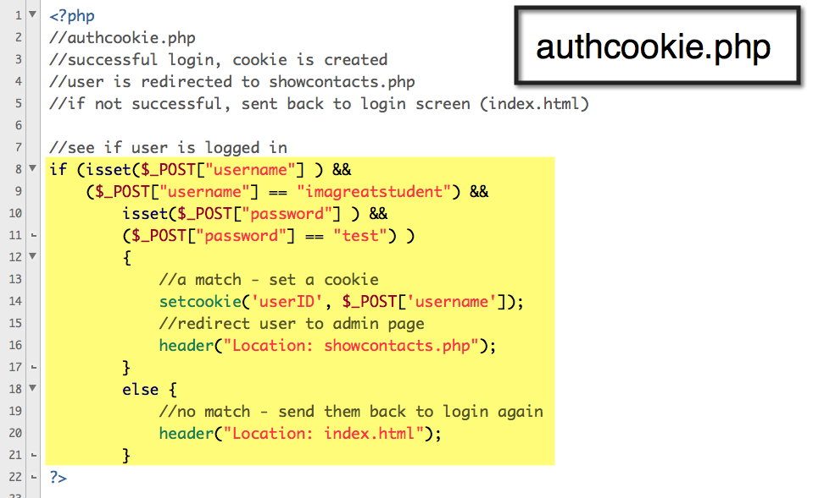

Slide 27
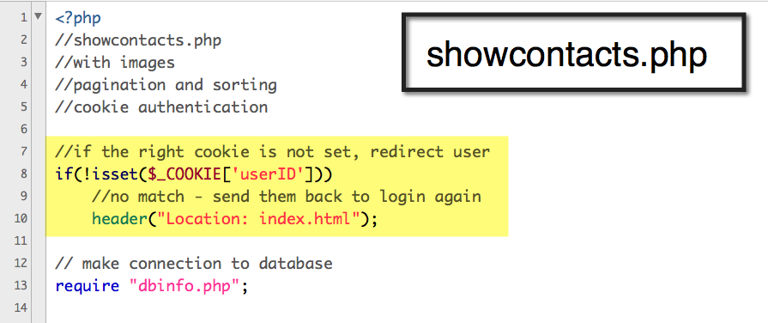

Slide 28
Logging Out – Deleting a Cookie
If you send a cookie that consists of a name without a value, it will have the same effect as deleting the existing cookie of the same name.
As an added precaution, you can also set an expiration date that is in the past

Slide 29
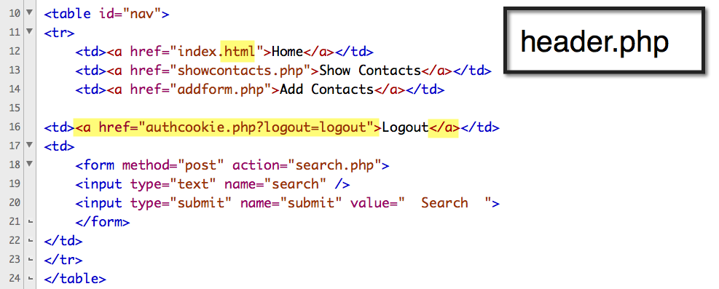

Slide 30
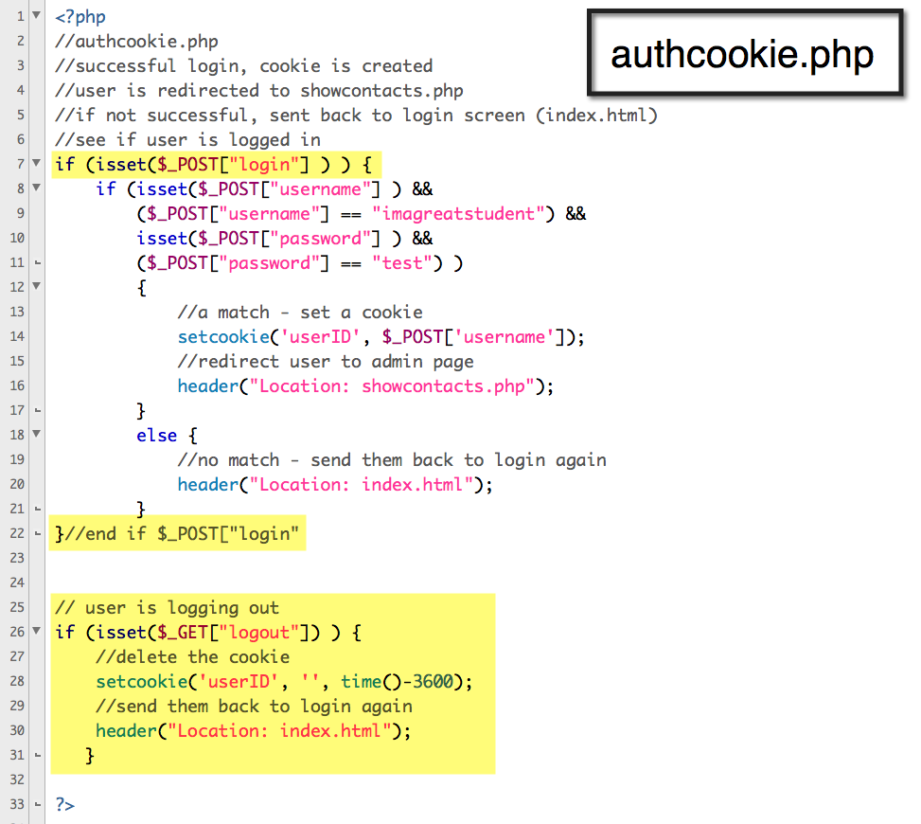

Slide 31

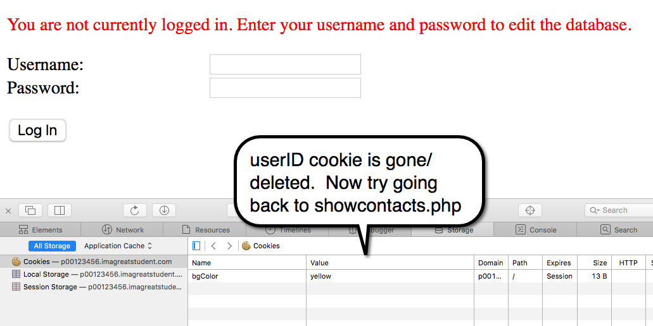
Click the Logout link to test it

Slide 32
Cookie Problems
You used a login/out script based on cookies.
What if cookies are disabled? Users can control that in their browsers.
If cookies are disabled, then they couldn’t use your web application. Uggh!
Instead, we can use the server to store login data. That’s next!

